Slide 2
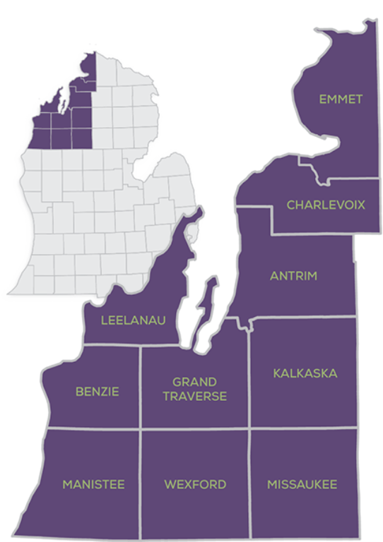
Organized in 2018 by a cross-sector group of regional housing partners
Working to overcome the communications, policy, and financial barriers that stand in the way of housing solutions.
Founded by partners including Rotary Charities of Traverse City, the Frey Foundation, and Networks Northwest

Slide 4
BECOMING A HOUSING ADVOCATE
AGENDA
Housing North – Who we are, what we do
Local Government 101
Communication Tools & Techniques
Engaging Local Government
Scenarios & Small Group Discussions
Wrap-up & Resources

Slide 5
Local Government & Housing: Zoning
What is it?
Determines what can be built and where – through zoning districts and allowed uses, site plan approvals, planned unit developments, special land use approvals, etc.
Common points of contention
Higher-density housing types
Planned unit developments
Accessory dwelling units/granny flats, rooming/boarding houses, duplexes
Who’s in charge?
Planning Commission makes recommendation to elected board for zoning changes
Elected board issues final action
Planning Commission sometimes has final approval on site plans or planned unit developments

Slide 6
Local Government & Housing: Tax & Other Incentives
What is it?
Payment in lieu of taxes (PILOT) reduces tax costs for developers and is required for certain funding programs
Land bank authorities and brownfield redevelopment authorities can provide low-interest loans or grants for certain activities
Common points of contention
Are we giving “handouts” to developers?
Who’s in charge?
Elected board issues approval for PILOT
County Land Bank Authority or Brownfield Authority can make some decisions
County Board approval required for some decisions

Slide 7
Local Government & Housing: Property Ownership
What is it?
Most local governments own some property – some of which might be appropriate for housing development
Common points of contention
Should local governments maximize profit from sale of property, keep for public use, or donate/sell at below-market value for needed housing?
Who’s in charge?
Elected board agrees to terms of sale, which can include specific provisions around the type of housing to be built

Slide 8
Communication Tips
Consider the frame: How issues are framed can change how people respond to it.
Be sure the audience understands the “why” of the issue
Messengers matter! People listen to people they trust
Focus on solutions: efforts to engage the public should be clear and directive
Make data meaningful
Words matter! Use certain words and avoiding others like: Homes, we, working people

Slide 9
Because of long-term trends, there is a real shortage of homes. Many middle-class workers young and old are no longer able to live in our towns and rural areas. We risk creating communities where only the wealthy can live.

Slide 10
How can I get involved?
The Homes for our Future campaign is a call to action from the public, local governments, employers, and community organizations. It aims to offer clear courses of action and resources about how to participate in housing solutions.
Get data and resources to support your advocacy efforts
Stay up-to-date with regional and local housing events
Sign up to receive updated information, newsletters and events
Request support for a presentation or local housing effort
Share your housing story to help build awareness
Help your community become Housing Ready

Slide 11
Questions & More Info
Sarah Lucas, Executive Director
Housing North
231-929-5034
sarah@housingnorth.org
Data available at:
www.Homesforourfuture.org

