Slide 1
HOUSING NORTH LEGISLATIVE INITIATIVES
June 8, 2 p.m.
Thank you for joining us!
Webinar reminders:
Please be sure your microphone is muted
Please submit questions during the presentation via the chat function
Questions will be answered after the presentation
Grants
Land donations
Tax incentives
Zoning changes for more diverse housing options
Public support

Slide 2
BARRIERS
Construction costs
Infrastructure
Labor shortage
Taxes
Zoning that restricts the type or amount of homes that can be built
Public opposition
Grant requirements designed for urban areas
SOLUTIONS
Grants, low interest loans, financial partnerships
Land donations
Tax incentives
Zoning changes for more diverse housing options
Build public support and understanding
Legislative or policy change to create more tools and revenue
We know we need more housing. Why not just build it?
Grants
Land donations
Tax incentives
Zoning changes for more diverse housing options
Public support
Notes:
Introduce the “Campaign” umbrella
What is it for? WHO is it for?

Slide 3
AWARENESS
Outreach, messaging & communications tools for communities, developers, other partners
ADVOCACY
Identify and influence policy that impacts development opportunities in rural Michigan.
CAPACITY & RESOURCES
Work with partners to develop and share new tools and explore funding options for housing

Slide 4
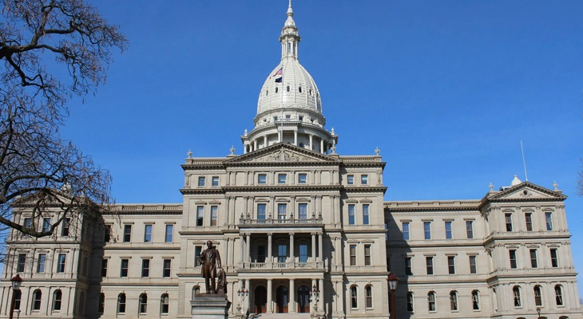
Housing North Policy Pillars
TAXES
Develop a new and innovative tax structure for property owners seeking to provide long-term (greater than one month) rental housing for the workforce
QAP FOR RURAL
Amend the MSHDA Qualified Allocation Plan (QAP) to better address rural housing needs
VACATION RENTALS
Mitigate impacts of short-term rentals on year-round housing stock
FUNDING
Create new and preserve existing revenue streams that can be used for housing initiatives
RURAL INTERESTS
Ensure that rural housing and related needs are considered part of the structure of state government

Slide 5
Housing North Policy Initiatives: Low Income Housing Tax Credit Program
QAP FOR RURAL
Amend the MSHDA Qualified Allocation Plan (QAP) to better address rural housing needs
QUALIFIED ALLOCATION PLAN (QAP) guides MSHDA investment in housing projects
Northern Michigan projects are uncompetitive because of preferred financing structure, densities, locations in QAP
Housing North recommendations for 2020 QAP update process:
Flexibility for walkability requirements
Lower points for certain financing approaches
Flexibility for transit requirements
Tier structure for proximity to amenities

Slide 6
Housing North Policy Initiatives: Employer Housing Incentives
TAXES
Develop a new and innovative tax structure for property owners seeking to provide long-term (greater than one month) rental housing for the workforce
Employer housing tax credit based on Illinois model
50% income tax credit on the value of a donation to a housing project
Rep. Tristan Cole has verbally committed to sponsoring a bill this month

Slide 7
Housing North Policy Initiatives: Expand Access to Payment-in-lieu-of-taxes
TAXES
Develop a new and innovative tax structure for property owners seeking to provide long-term (greater than one month) rental housing for the workforce
Tax abatement issued by local governments for qualifying workforce housing in rural areas (possibly all community types for greater statewide impact)
Expand the concept of payment-in-lieu of taxes (PILOT) to housing developments not funded by state or feds
Would allow higher incomes than those currently addressed by PILOT
Allows communities to identify income thresholds and other parameters
Senator Wayne Schmidt has verbally committed to sponsoring a bill (currently in draft form)

Slide 8
Housing North Policy Initiatives: Residential Facilities Exemption
TAXES
Develop a new and innovative tax structure for property owners seeking to provide long-term (greater than one month) rental housing for the workforce
12-year tax abatement based on Industrial Facilities Exemption
Local governments establish districts; individual property owners can apply for 50% tax abatement
Qualifying housing development would follow locally-established parameters

Slide 9
Housing North Policy Initiatives: Principal Residence Exemption Expansion
TAXES
Develop a new and innovative tax structure for property owners seeking to provide long-term (greater than one month) rental housing for the workforce
Homestead credit granted to long-term rental properties
Make workforce rentals more affordable
Incentivize long-term rentals (vs use of property as a short-term rental)
Rep. Tristan Cole has verbally committed to sponsoring a bill this month (currently in draft form)

Slide 10
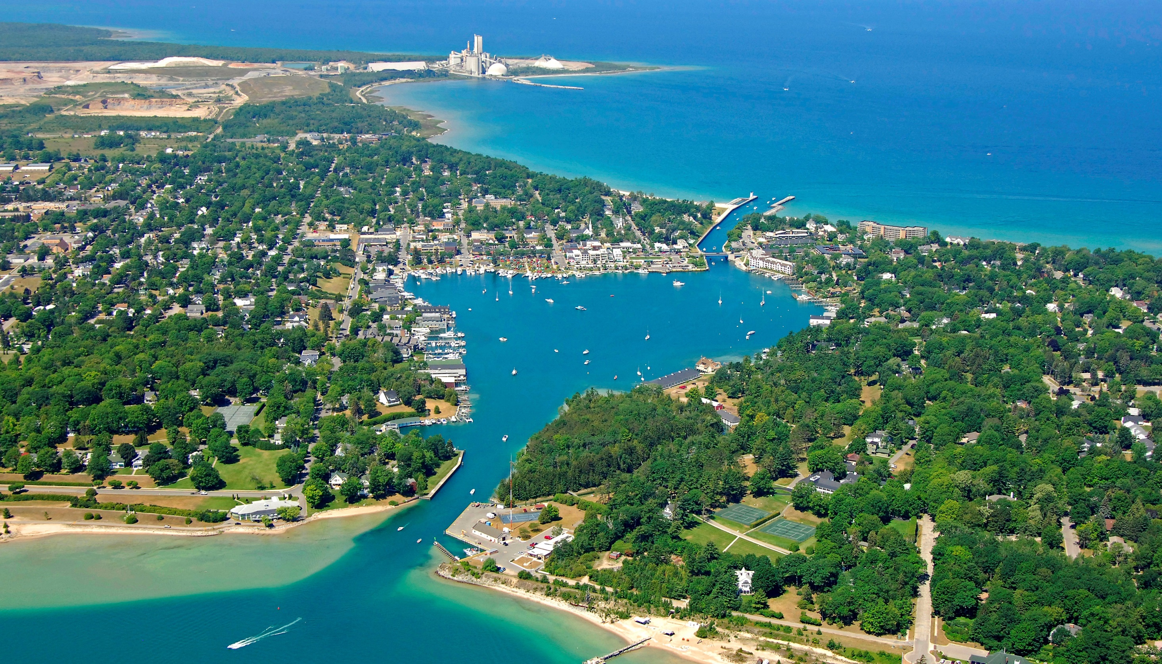
Housing North Capacity-Building Goal: Creating New Sources of Housing Funds
Housing Funding
Create new and preserve existing revenue streams that can be used for housing initiatives
Local and regional funds can…
Pool and leverage resources and investment from CDFIs, private donors, and local governments
Meet development needs that are harder to fund – like predevelopment or site control
Work in tandem/partnership with land bank authorities and other partners
$
$

Slide 11
Housing North Legislative Initiatives: Generating Local Revenue for Housing
Housing Funding
Create new and preserve existing revenue streams that can be used for housing initiatives
Regional Housing Authority to allow for multi-jurisdictional housing millage
Revenues could be used for a broad range of housing/homeless services, development, programs
Based on transit authority legislation/Colorado housing authority model
$
$

Slide 12
Housing North Legislative Initiatives: Creating Statewide Revenue for Housing
Housing Funding
Create new and preserve existing revenue streams that can be used for housing initiatives
Michigan Housing & Community Development Fund was created in 2008 to fund housing, homelessness services, and downtown/neighborhood improvements
An ongoing revenue source is needed. Many states use a real estate transfer tax; another option may be a document recording fee.
Michigan is one of only 3 states that doesn’t have an operational statewide housing trust fund
Research and participation from state agencies/legislators is needed to identify and enact appropriate revenue sources
$
$

Slide 13
Housing North Legislative Initiatives: Creating Additional Federal Resources for Housing
Housing Funding
Create new and preserve existing revenue streams that can be used for housing initiatives
Affordable Housing Credit Improvement Act (HR 3077/S 103)to expand and enhance resources for the affordable housing tax credit program
Increase housing credit allocations
Create additional opportunities for access to credits for rural communities
Increase access for hard-to-serve communities like rural, Native American, high poverty, and high-cost areas
Broadly sponsored in US House of Representatives; we are encouraging Rep. Bergman to co-sponsor
$
$

Slide 14
The Homes For Our Future campaign is a CALL TO ACTION for the public, local governments, employers, and community organizations. It aims to offer clear courses of action and resources for how to participate in housing solutions:
Advocate
Endorse the campaign
Contact your legislators
Become a Housing Ready Community
Learn about housing needs, solutions, best practices, and success stories
Notes:
Introduce the “Campaign” umbrella
What is it for? WHO is it for?

Slide 15
CLEAR MESSAGE & COMMON LANGUAGE
Communications resources for advocates, local governments, and others to support conversations about housing
Information in the toolkit (and online) includes:
Definitions
Income levels
Housing needs/studies
Talking points
Messaging “frame”
Links to resources

Slide 16
How can I help?
Endorse the Homes for Our Future campaign with a resolution of support
Contact your legislators! Contact information and talking points on homesforourfuture.org
HOUSING
NOW!
Notes:
You’re doing it right now by being here! You’re learning and hopefully you will teach what you’ve learned to others, but there’s more you can do. Show up, Speak up, post comments, write letters…

Slide 17
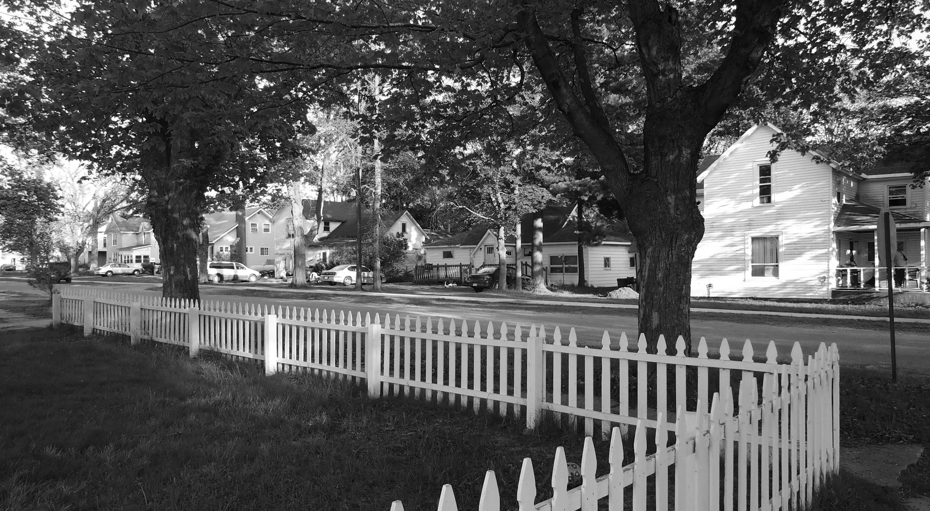
Housing North Partnerships
We need local and regional support for our regional advocacy, communications, and capacity-building work
Support housing communications, awareness and education, and legislative advocacy
Opportunities for leadership and strategic organizational guidance
Recognition of your organization’s participation in housing solutions
Notes:
You’re doing it right now by being here! You’re learning and hopefully you will teach what you’ve learned to others, but there’s more you can do. Show up, Speak up, post comments, write letters…

Slide 18
Questions & More Info
Yarrow Brown
231-335-1685
yarrow@housingnorth.org
Sarah Lucas
231-920-2116
sarah@housingnorth.org
Data available at:
www.housingnorth.org
www.homesforourfuture.org

